Slide 1
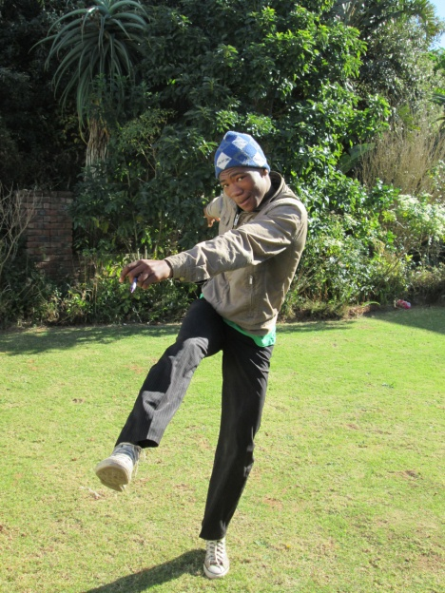
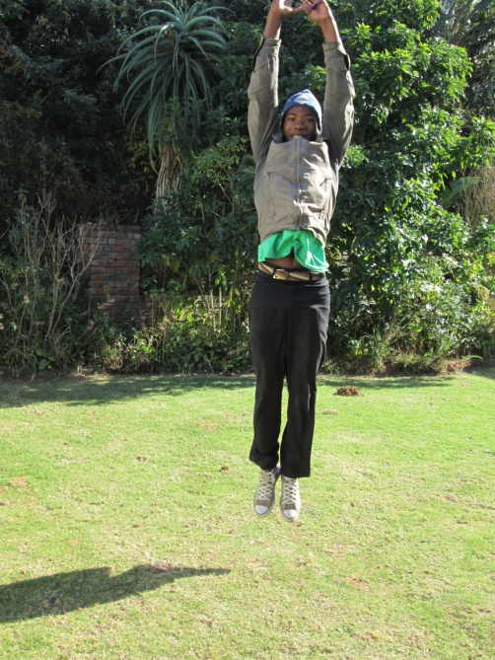
About me
Notes:
Am LISOLETH MHLAMBENI.
I LIVE HERE AT CINTSA EAST I LIVE WITH MY SISTER I AM 18 YEARS OLD. I WORK AT BAREFOOT. I LOVE PEOPLE

Slide 2
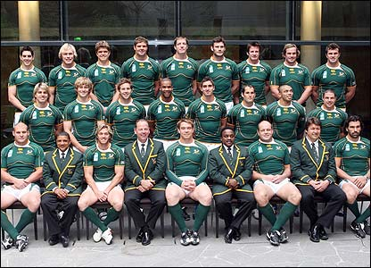
MY SPORT
Notes:
To keep your self

Slide 3
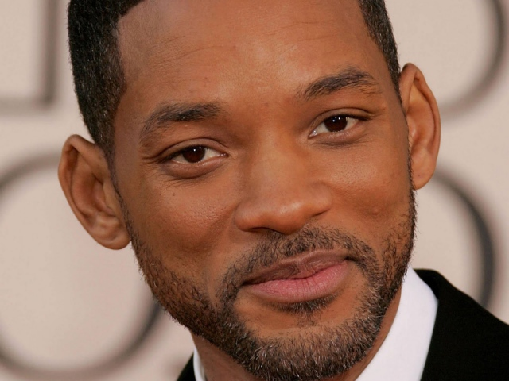
SOMETHING ELSE I WANT TO DO
Notes:
I don’t at one thing in life. So that you don’t lose hope in your life

Slide 4
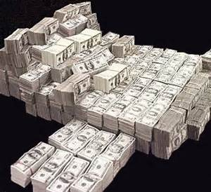
SALARYS

Slide 5
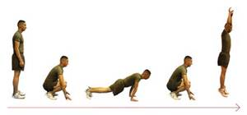
EXERCISE
Notes:
You have to exercise everyday. To keep your body healthy.

Slide 6
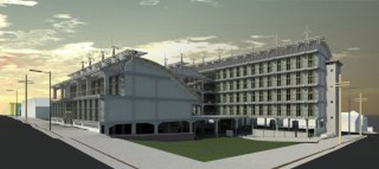
UNIVERSITIES
Notes:
IS NOT A MUST TO GO TO THE UNIVERSITIES BUT YOU HAVE TO GET MORE KNOWLAGE.

Slide 7
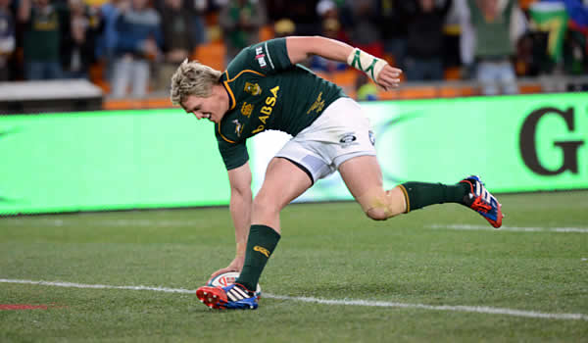
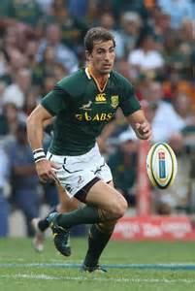
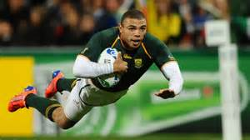
Role model
Notes:
WHEN YOU WANT TO BE SOMRTHING IN LIFE. YOU NEED TO HAVE A ROLE MODEL. LIKE SOMEONE YOU LOOK UP TOO. FOR EXAMPL TEXAS PRO FROM TEXAS LIKE LORI

Slide 8
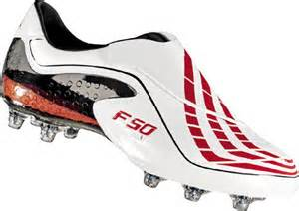
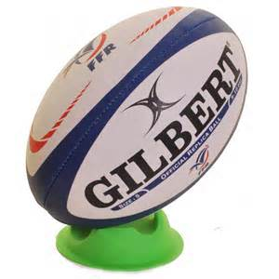
THINGS I NEED TO HAVE
Notes:
THIS IS WHAT WE NEED WHEN YOU ARE A PRO RUGBY PLAYER

Slide 9
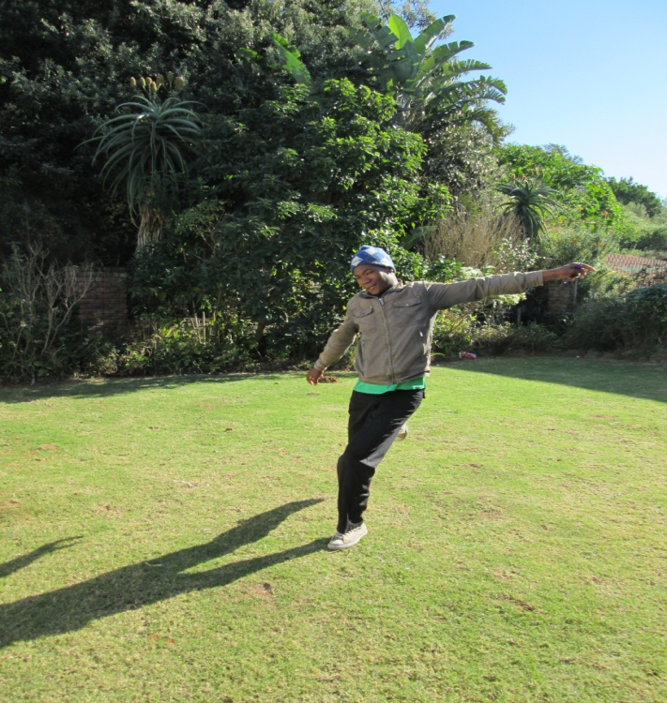
learned
Notes:
I’ve learned that to be a professional rugby player you have to be kind, nice to people, and you have to be fit every day. I hope to be a rugby player.

